Slide 1


Global Task Force for Paediatric
Musculoskeletal Health

Slide 2
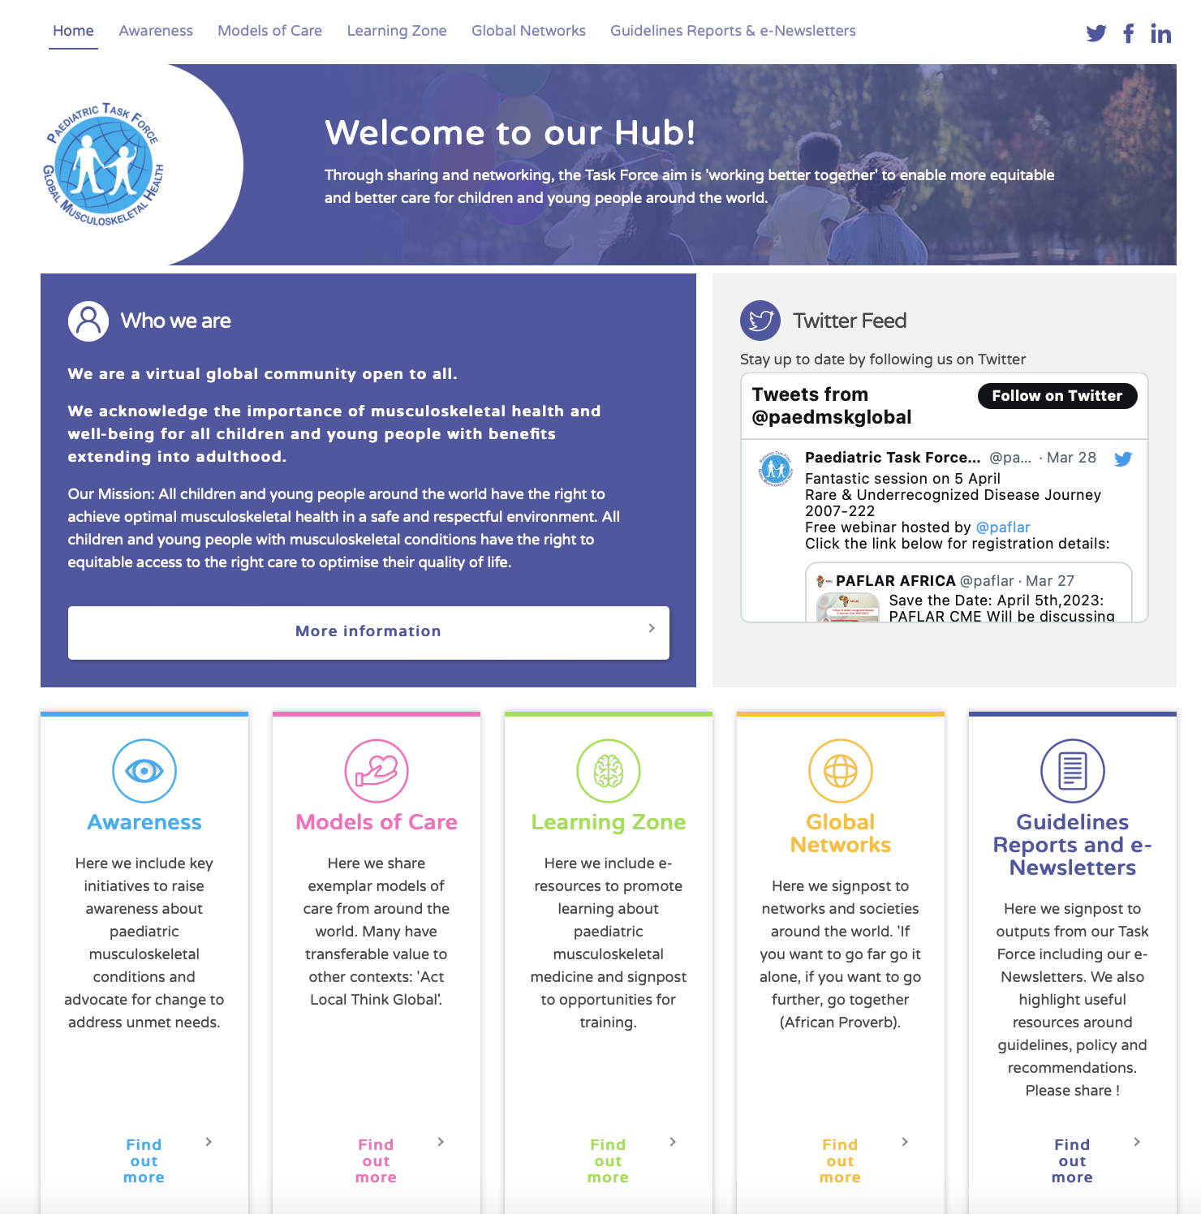
https://www.pmskglobal.com

Slide 3

Paediatric Global Musculoskeletal Task Force
Founded in 2018 (led by Helen Foster): Global Alliance for Musculoskeletal Health (G-MUSC) & aligned to WHO strategy
  Promoting investment in MSK health: ‘a call to action’
  Breadth of ‘musculoskeletal’ – rheumatology, orthopaedics
  Life course approach: many adult MSK morbidities have origins in childhood
Joined forces PReS Global Task Force (led by Chris Scott) June 2019
A Global Community with a shared vision to improve MSK health for all children
  Promotion : Awareness of unmet need
  Prevention : Obesity, road safety, accidents & injuries, promote healthy lifestyle (diet, exercise)
  Treatment : Equitable access to ‘right’ care
Notes:
)

Slide 4
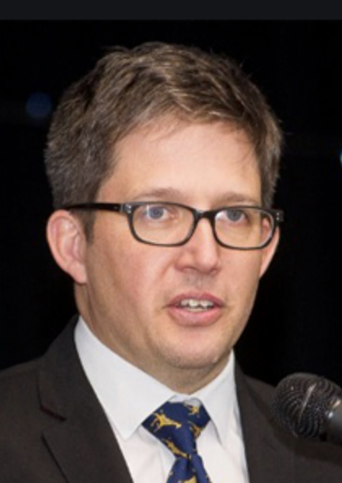
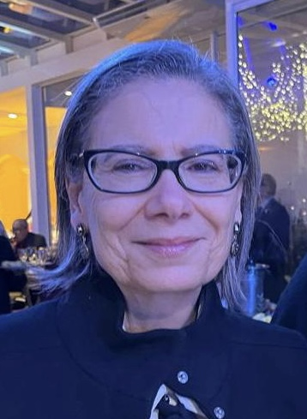
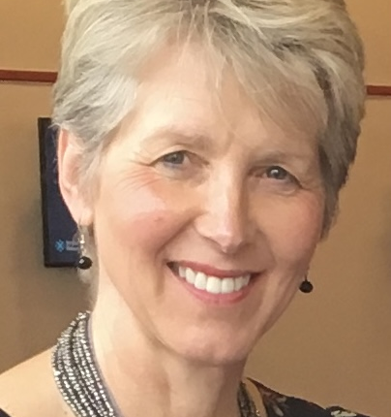
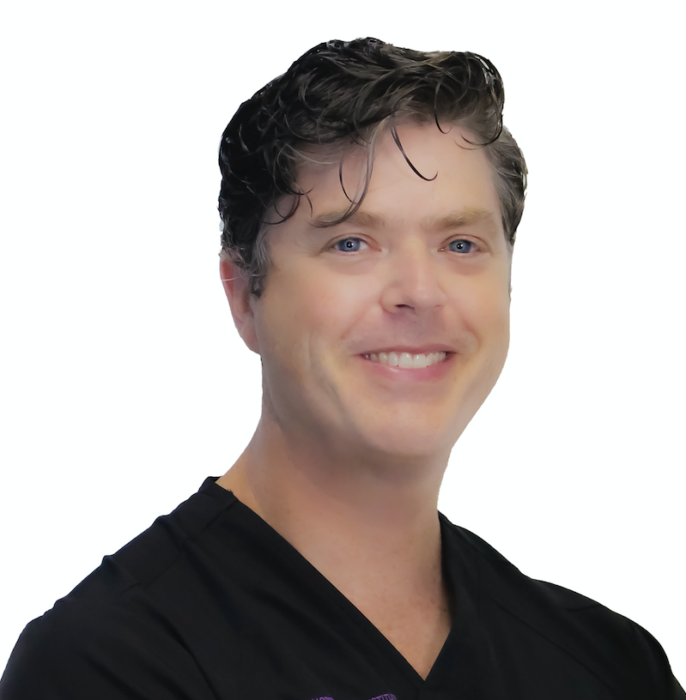
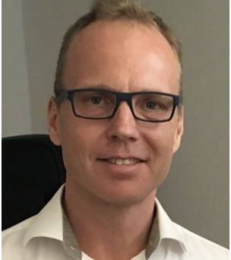
Co-Chairs (2023)
  Chris Scott (paed rheum), Claudia Saad Magalhees (paed rheum)
  Helen Foster (Founder Co-Chair paed rheum),
  Matthew Dobbs (paed ortho), Carl Johan Tiderius (paed ortho)
Links with multiple associations & networks
  Rheumatology, orthopaedics, family groups & charities
  PReS, APLAR, PAFLAR, PANLAR, WOC, WORD-Day
  WHO - Essential Medicines List, MSK Rehabilitation guidelines
Open global community, social media, e-Newsletters
Chris Scott (South Africa)
Helen Foster (UK)
Claudia Saad Magalhaes (Brasil)
Twitter LinkedIn FaceBook
Website: https://www.pmskglobal.com
e-Newsletters disseminated via PReS and available https://www.pmskglobal.com/guidelines-reports-e-newsletters/
Regional networks (e.g APLAR SIG, PAFLAR, PANLAR, ANZPRG, ArLAR, PReS)
E-Newsletter contributions are very welcome !
Twitter @paedmskglobal
Matt Dobbs (US)
Carl Johan Tiderius (Sweden)

Slide 5
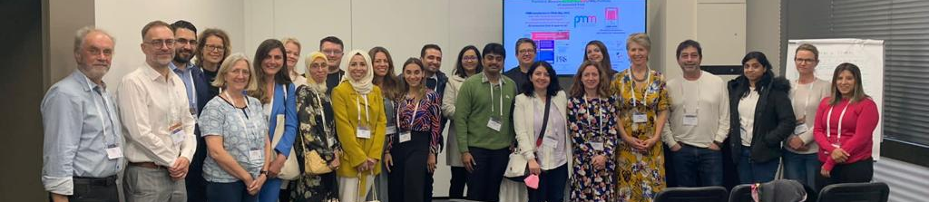
Global Task Force and PMM Editorial Board meeting Prague 2022
First ‘face to face’ since 2019

Slide 6

‘Working better together’
Networking & information sharing hub
Inspiring & supporting
Addressing challenges with real action
Advocating & giving a voice
“If you want to go fast, go alone.
If you want to go far, go together” - African proverb

Slide 7
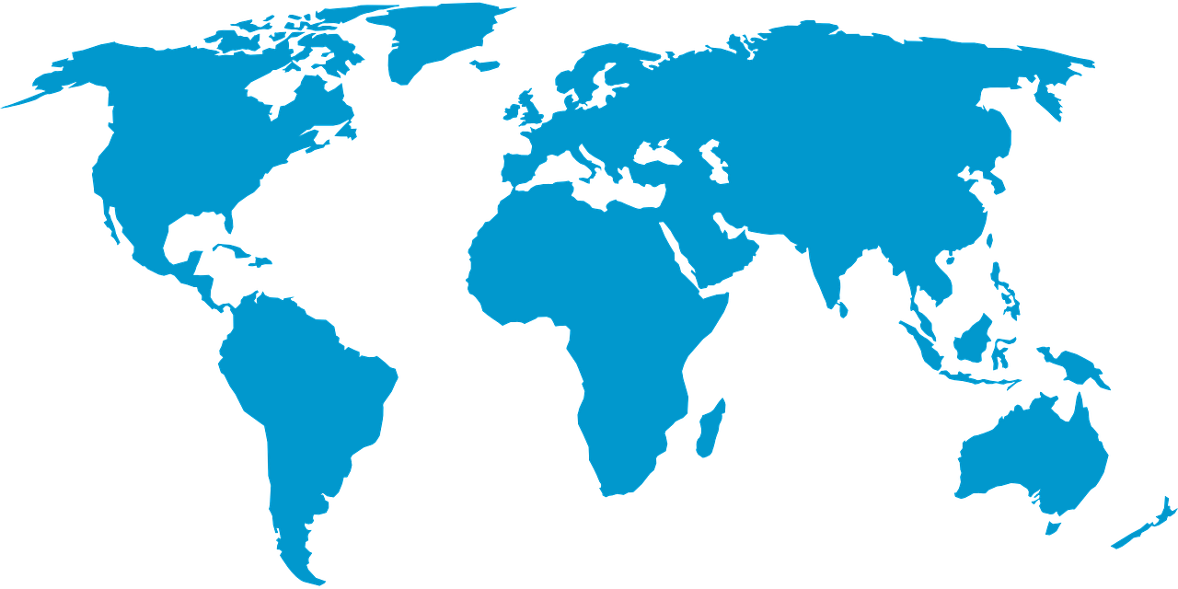
Global Task Force Steering Committee with members from around the world
(rheumatology, orthopaedics, allied health, parent advocates)
https://www.pmskglobal.com/about-us/

Slide 8
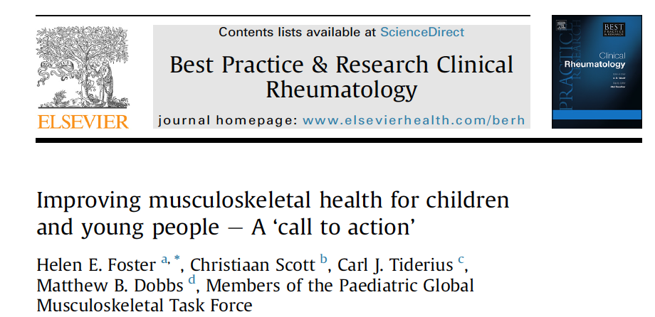
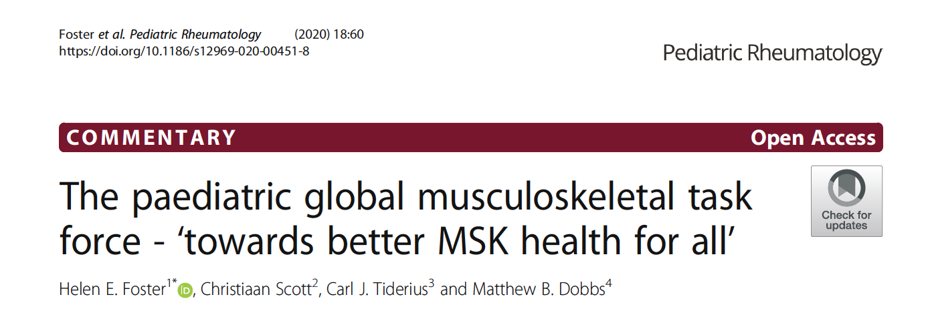
Awareness
Workforce capacity building
Research agenda
Education and training
Advocacy
https://doi.org/10.1016/j.berh.2020.101566

Slide 9
engage widely multi-disciplinary multi-professional
identify
exemplar solutions
foster collaborations to extend benefit
share & disseminate resources
'working better together'
learning from each other
'do not reinvent the wheel'
'low hanging fruit'
high impact for 'cost'
Notes:
Keep identity of all players ☺

Slide 10
Awareness
Workforce capacity building
Models of care
Advocacy
Education and training
Examples of our work and contributions
WHO EML (Joint diseases) revision (submitted 2022)
WORD day
APLAR and PAFLAR Webinar series
PMM Editorial Board and pGALS dissemination
pGALS translations
Australian Parliamentary Inquiry
E-Newsletters
Juvenile Arthritis Early Referral Tool
Clinical Guidelines (Less resourced countries)
International Meetings and Presentations

Slide 11
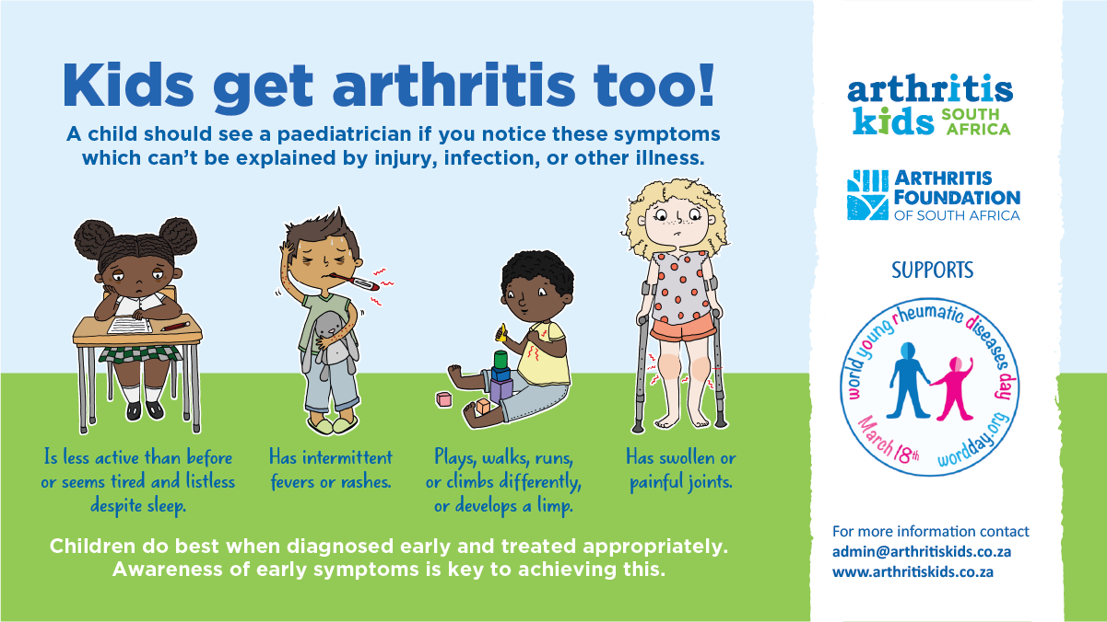
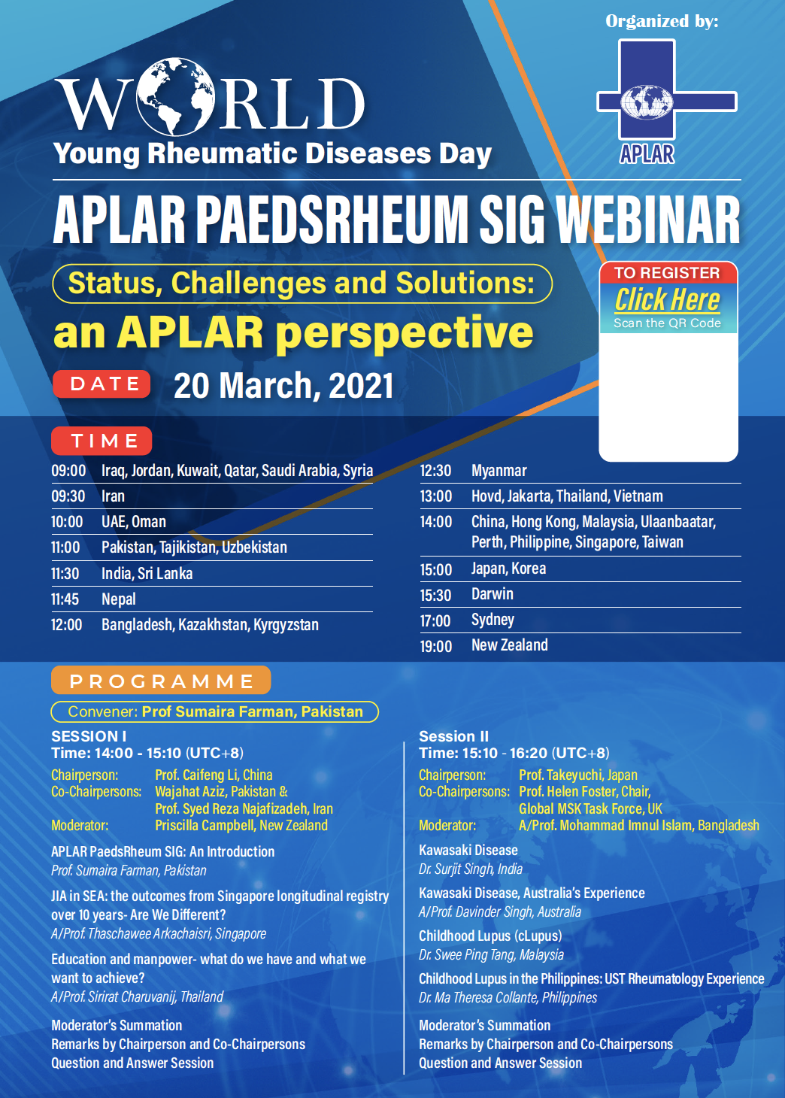
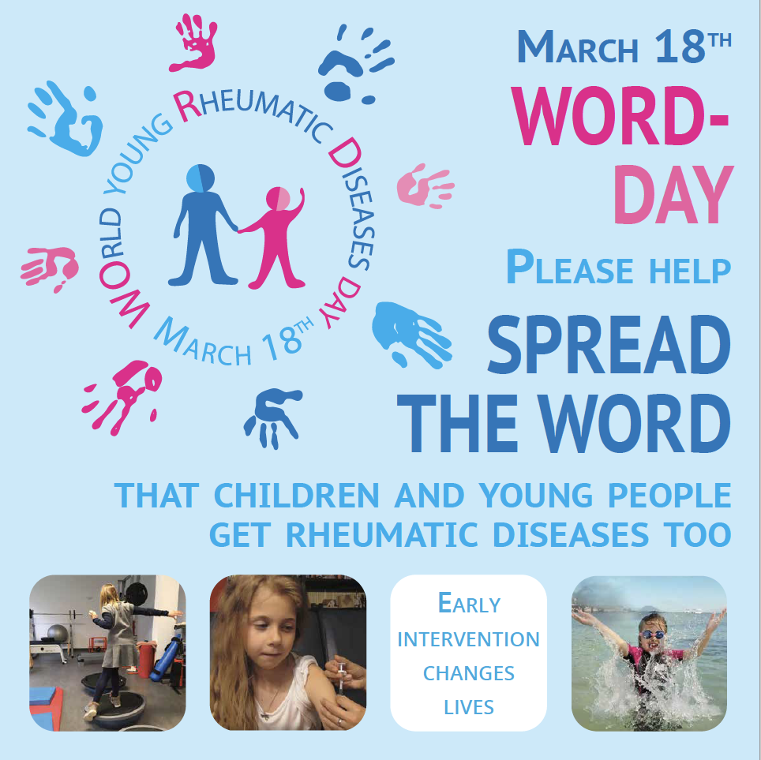
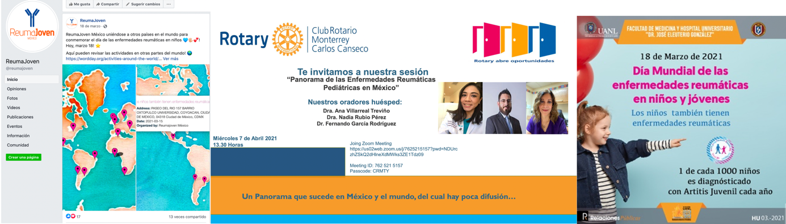
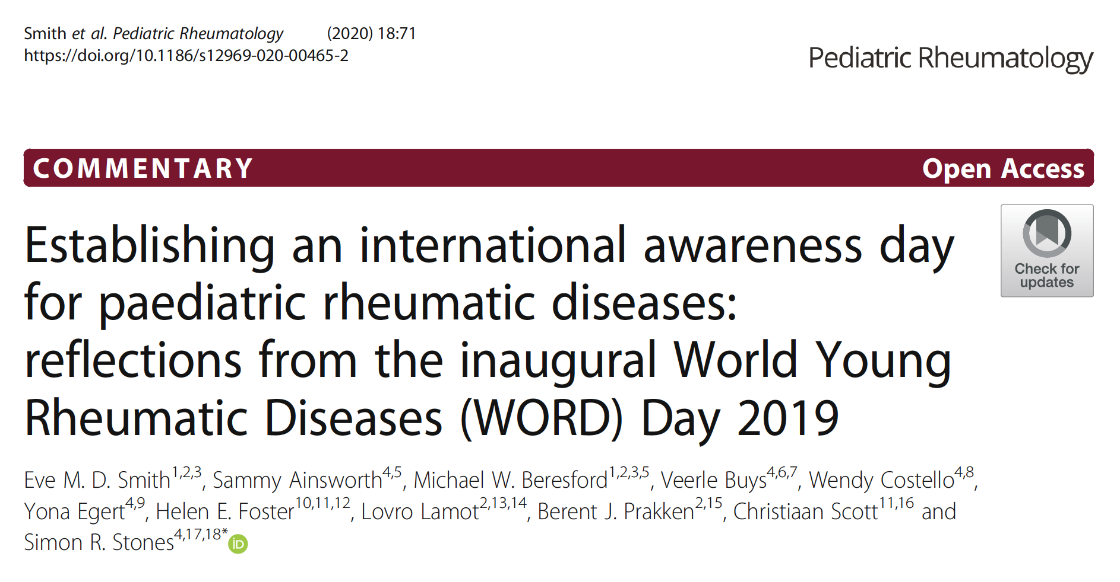
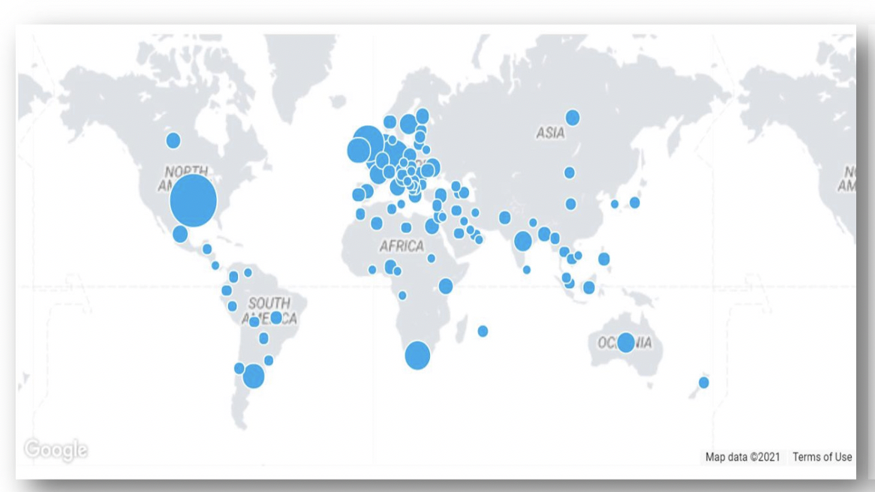
Awareness

Slide 12


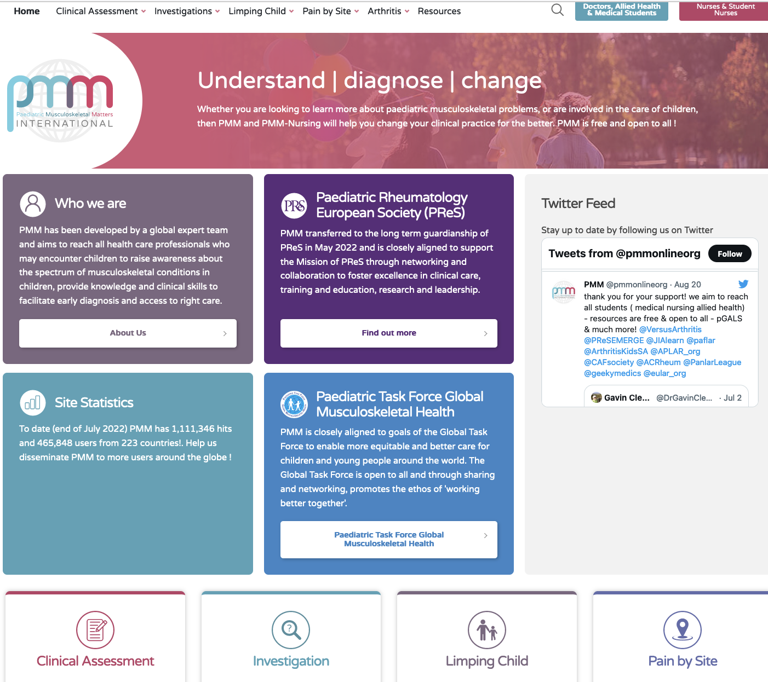
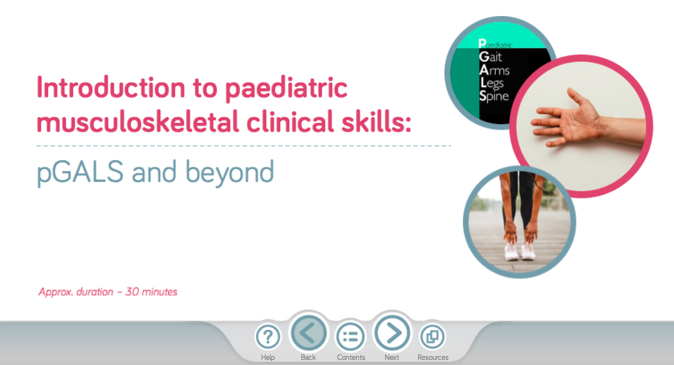
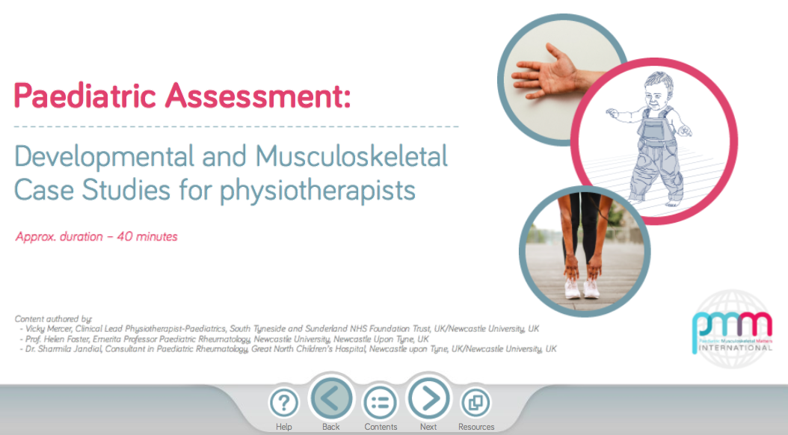
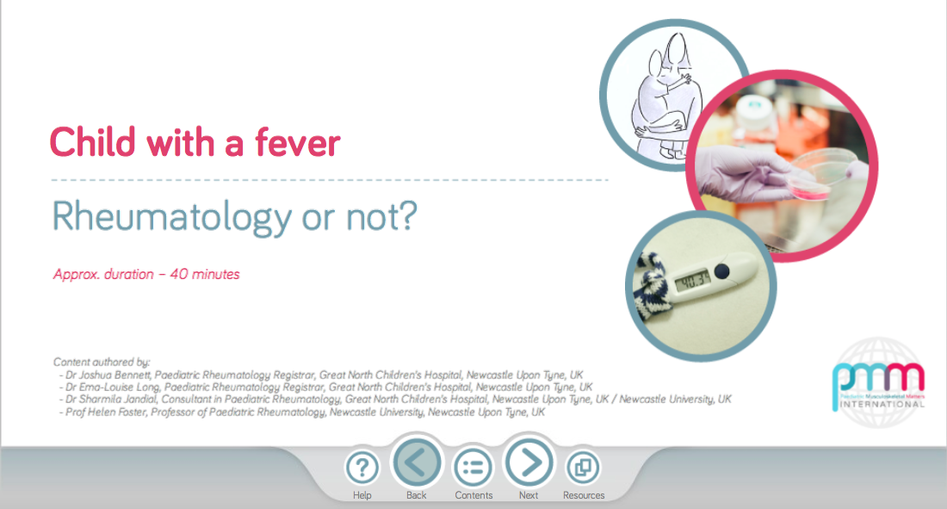
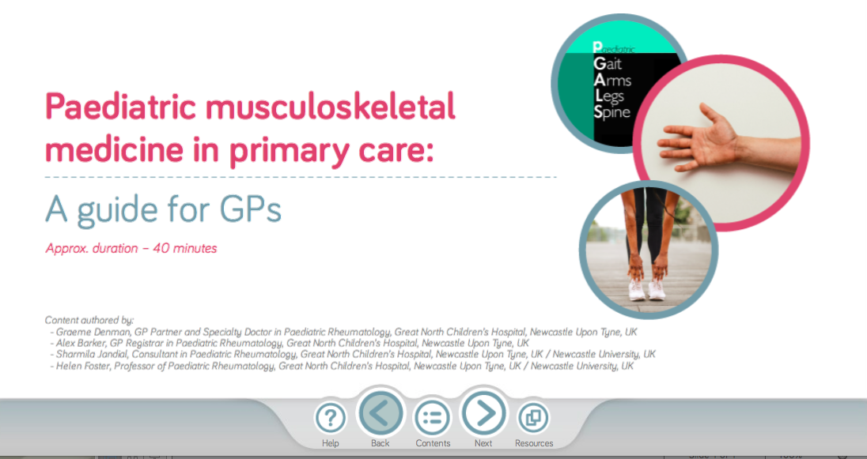

www.pmmonline.org
Paediatric Musculoskeletal Matters Portfolio
Updated Expanded Version Launched Sept 2022 with >70 global partners contributing content
Resources free & open to all for teaching and learning
Many pGALS translations
and v-pGALS for telemedicine
Interactive e-modules and pGALS graphic animation all available on PMM

Slide 13


pGALS Translations
23 (so far) developed with many global partners
V-pGALS for telehealth
All free, openly available on pGALS App &
  https://www.pmskglobal.com/learning-zone/
  https://www.pmmonline.org/doctor/clinical-assessment/examination/
If you want help add further languages
– please do get in touch with the PMM team
  pmmonline.org@gmail.com

Slide 14
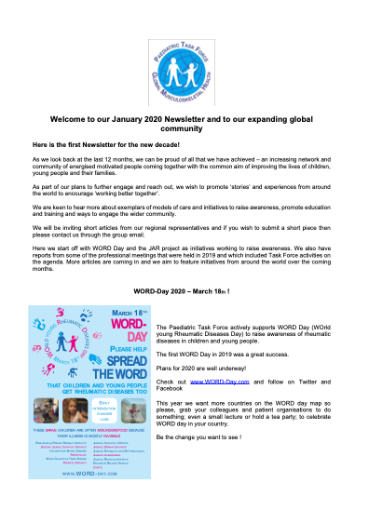
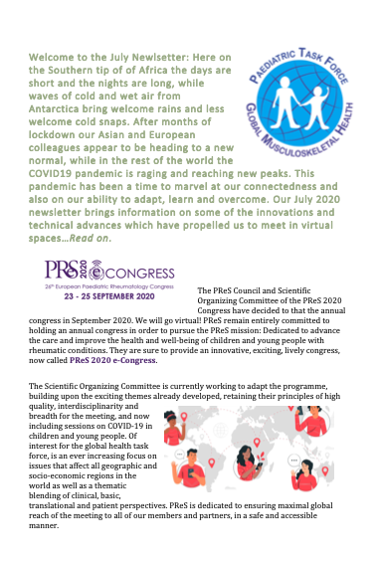
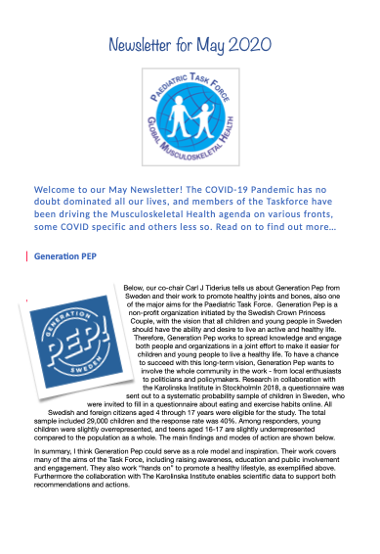
Regular e-Newsletters with contributions from around the world
www.pmskglobal.com/guidelines-reports-e-newsletters/

Slide 15
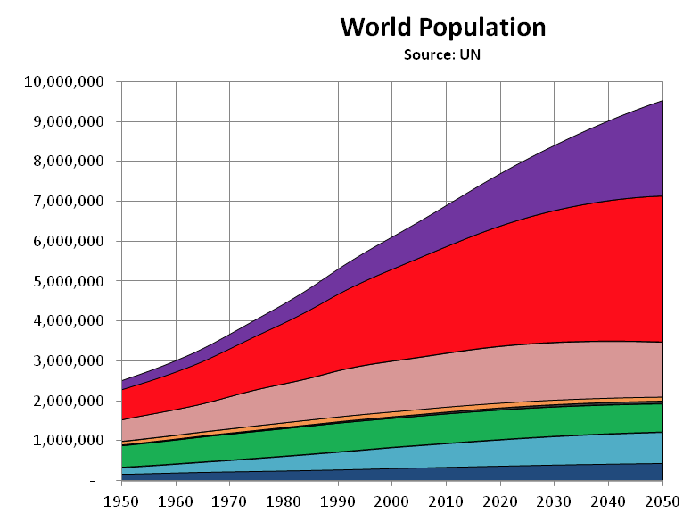
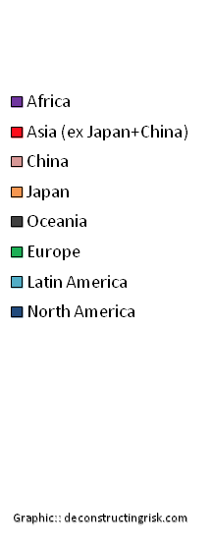
By 2050 2 out of every 5 children will live in Africa

Slide 16
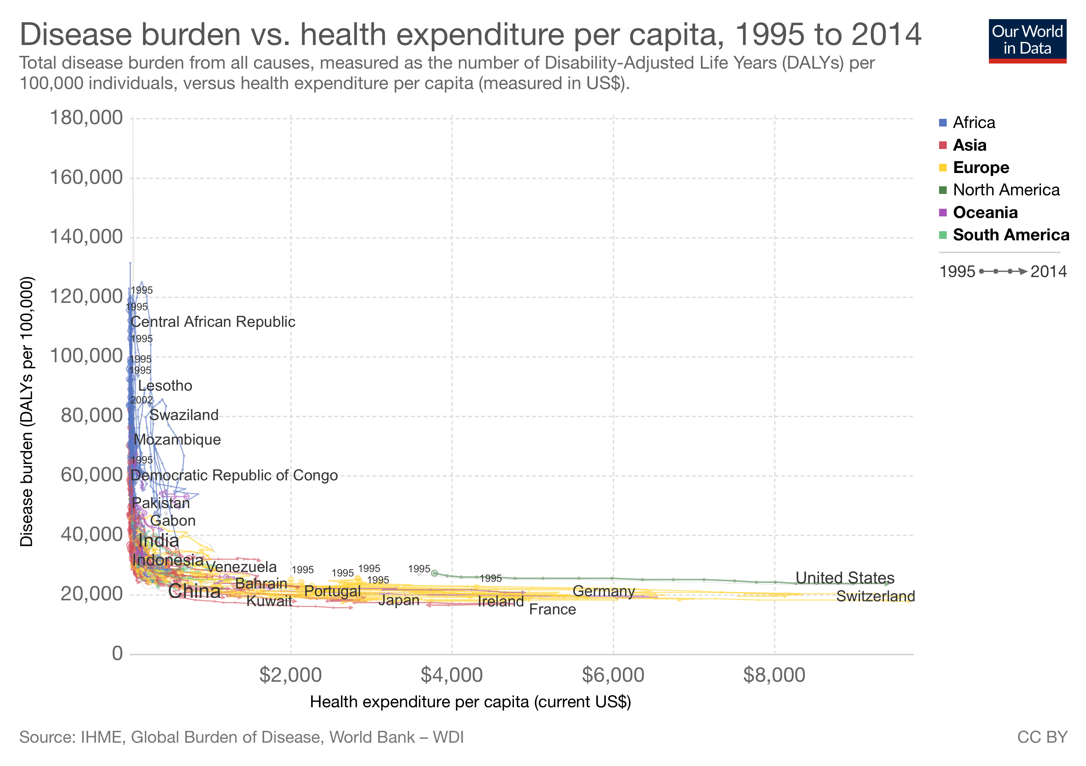
Notes:
The world is divided is divided economically and disease burden vs spending on healthcare are incersely related..the disease burden in poorer countries is largely driven by communicable diseases

Slide 17
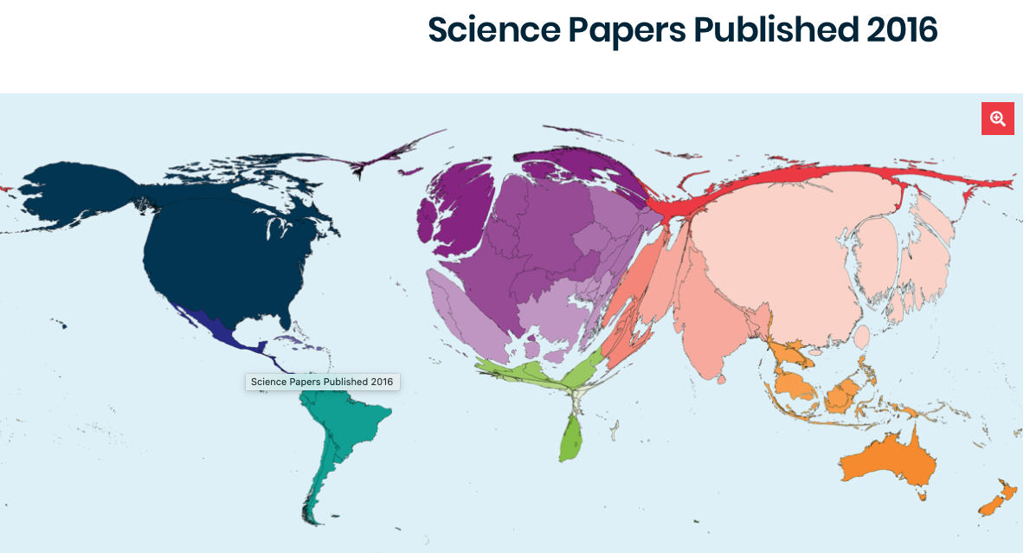
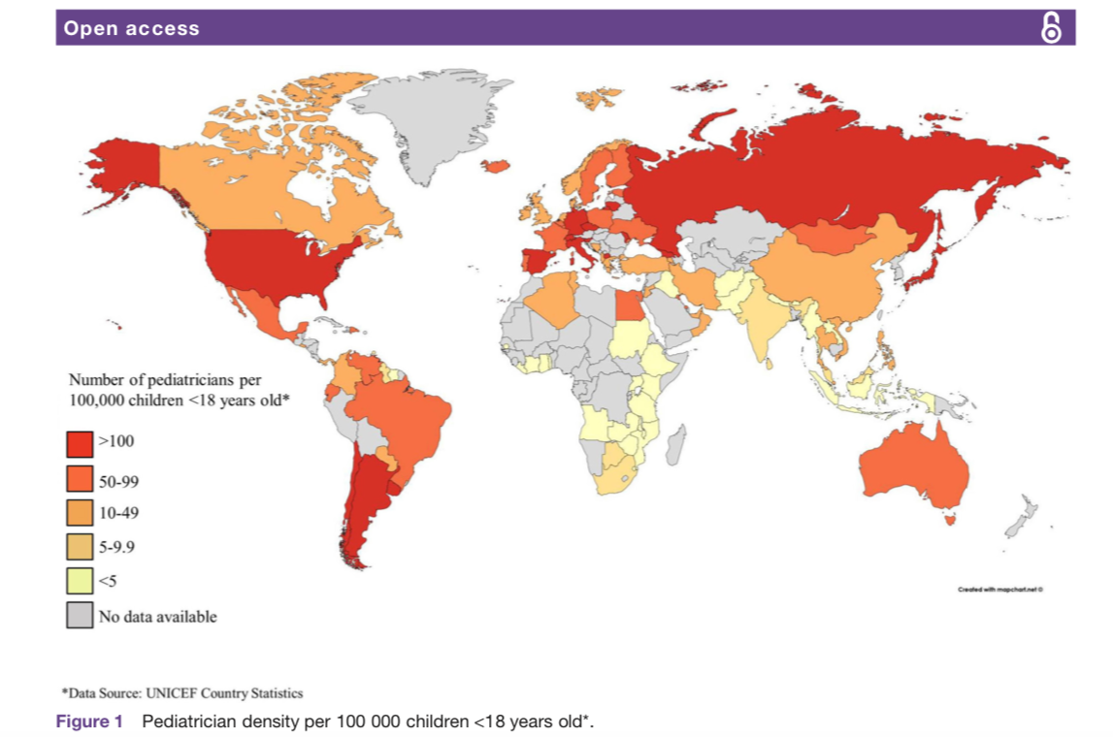
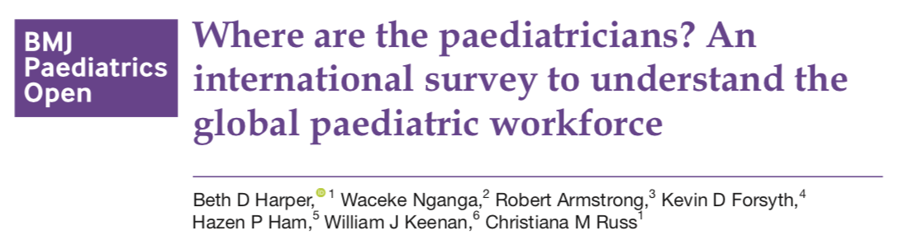

Slide 18
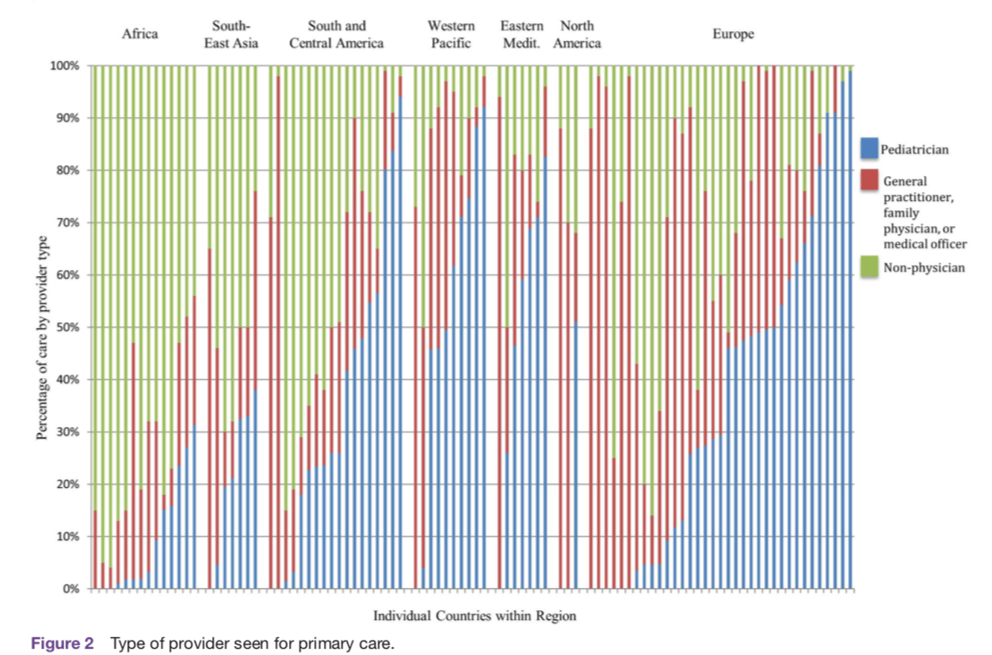

Slide 19
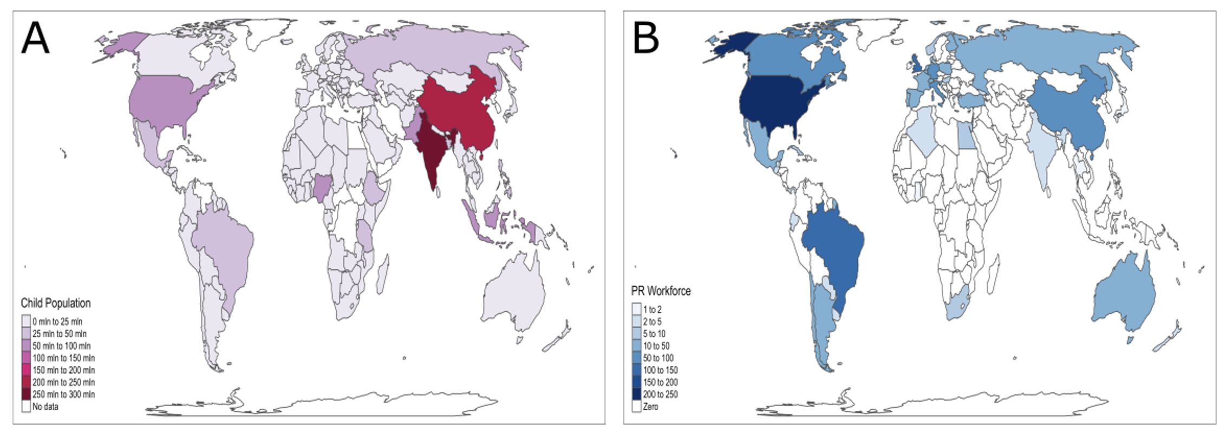
WORLDS CHILDREN
WORLDS PAEDIATRIC RHEUMATOLOGISTS
Scott, Sawhney, Lewandowski 2020

Slide 20
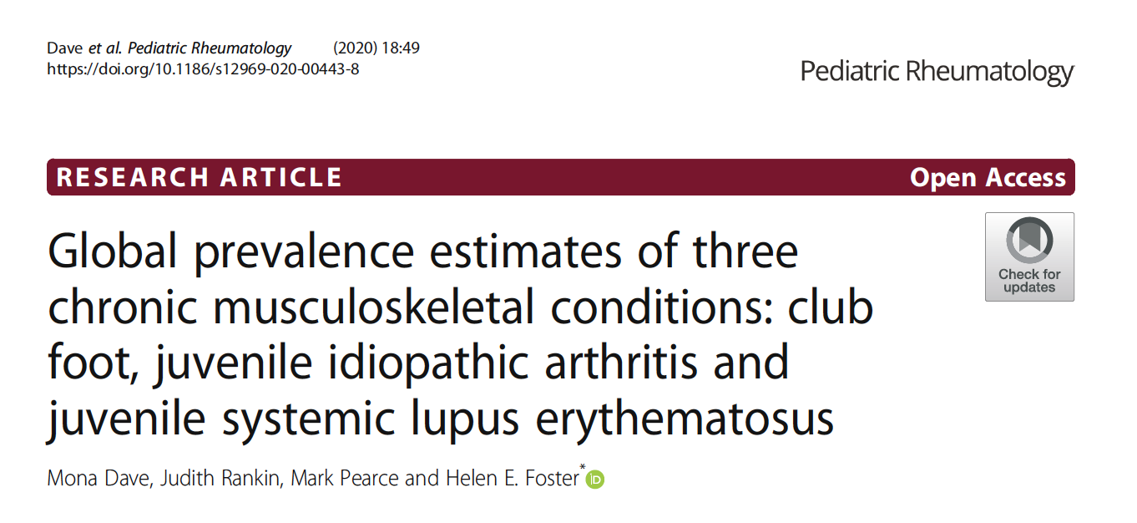
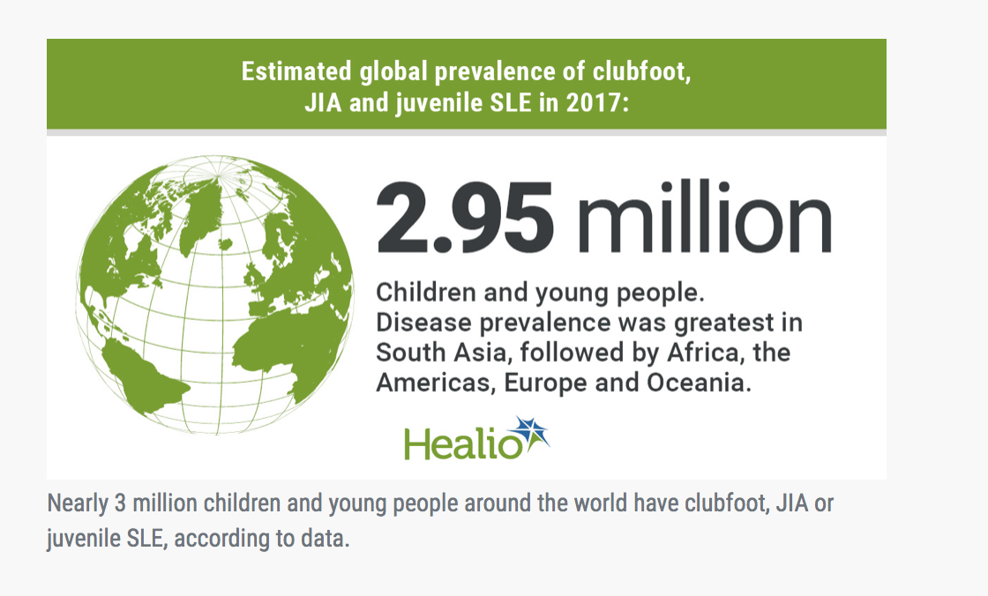
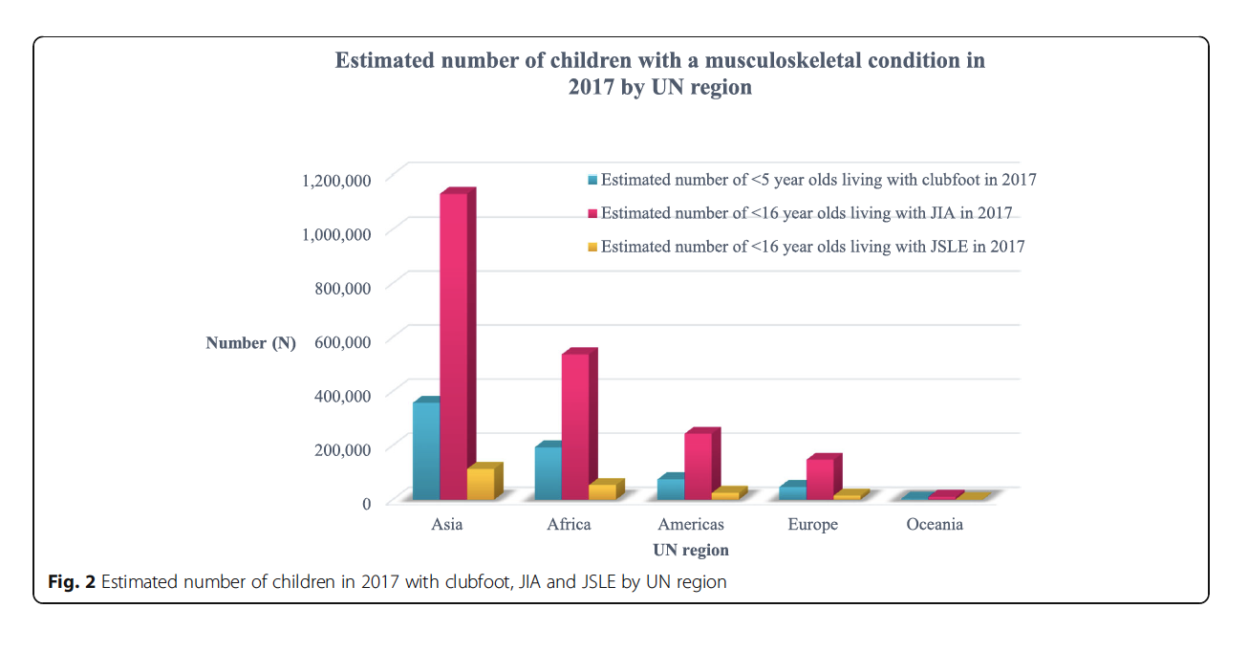
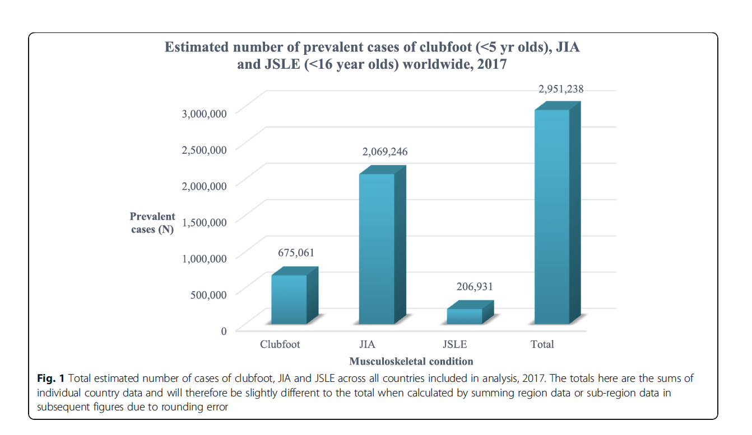

Slide 21
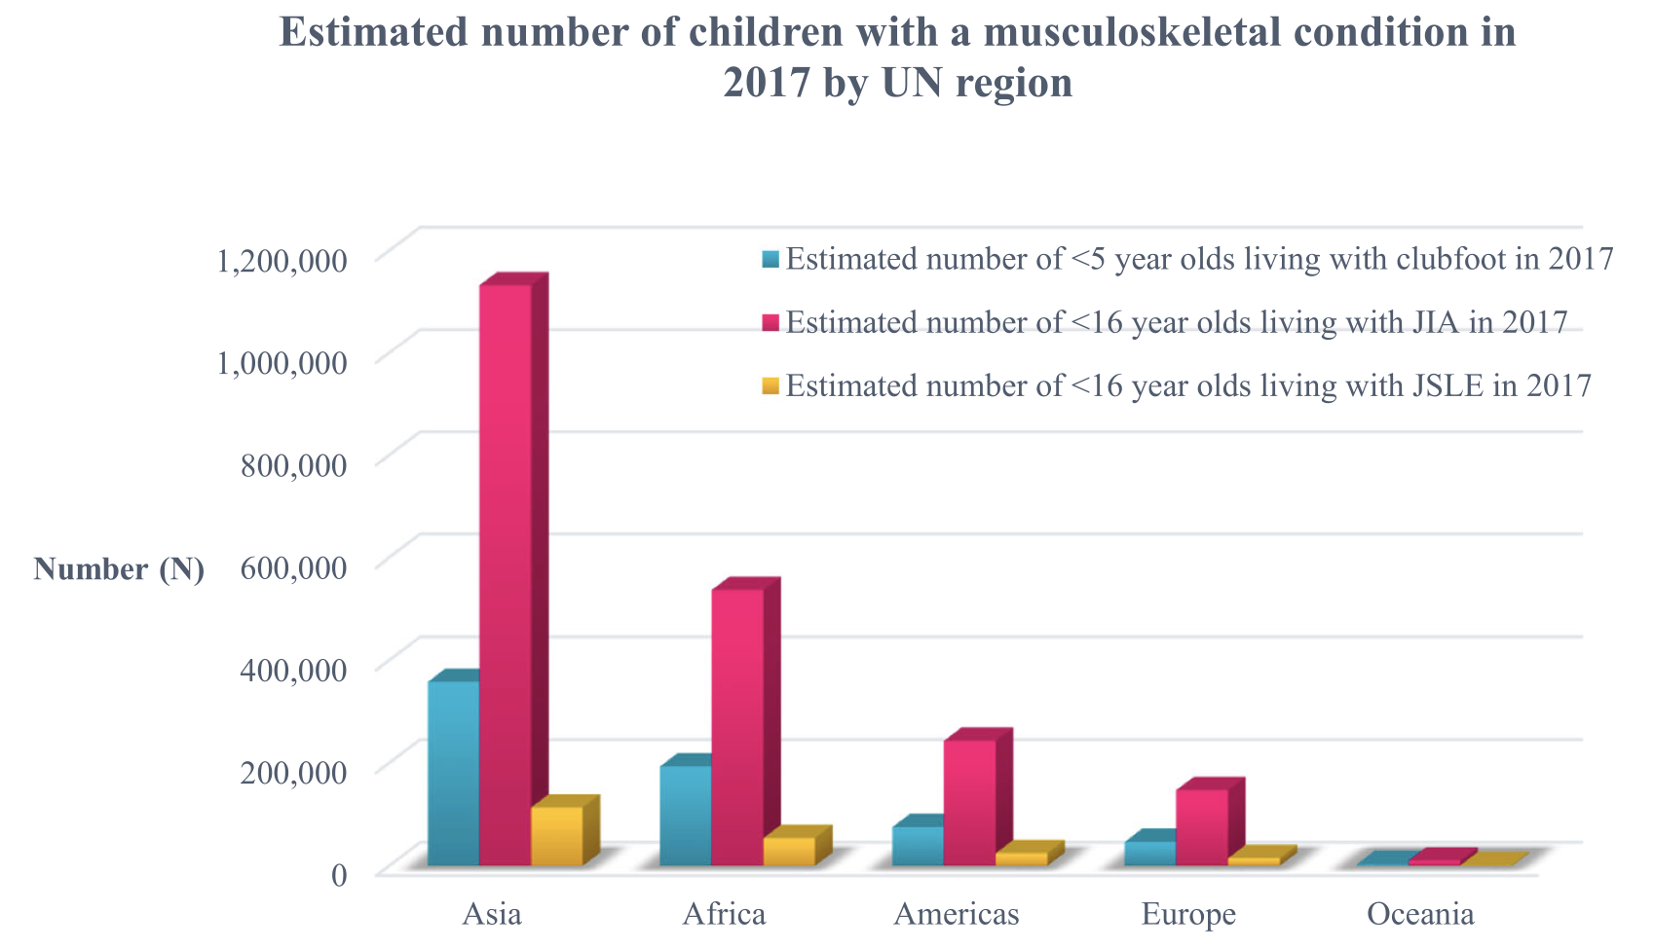
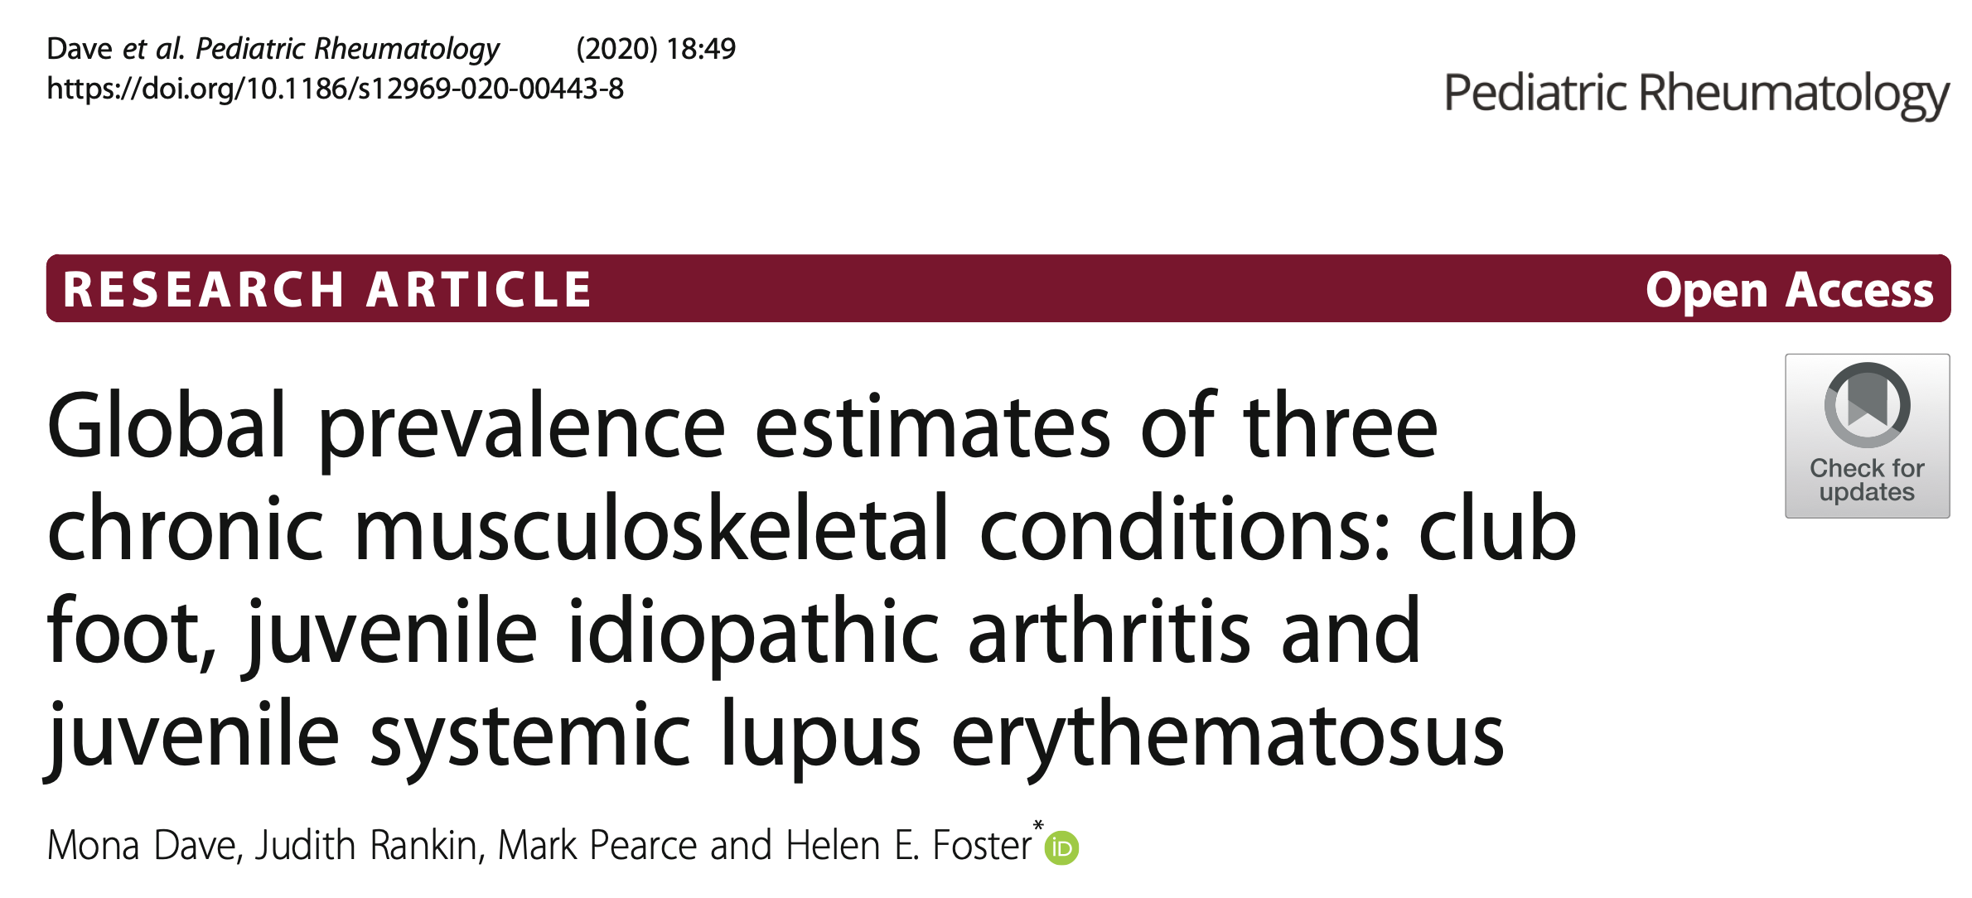

Slide 22
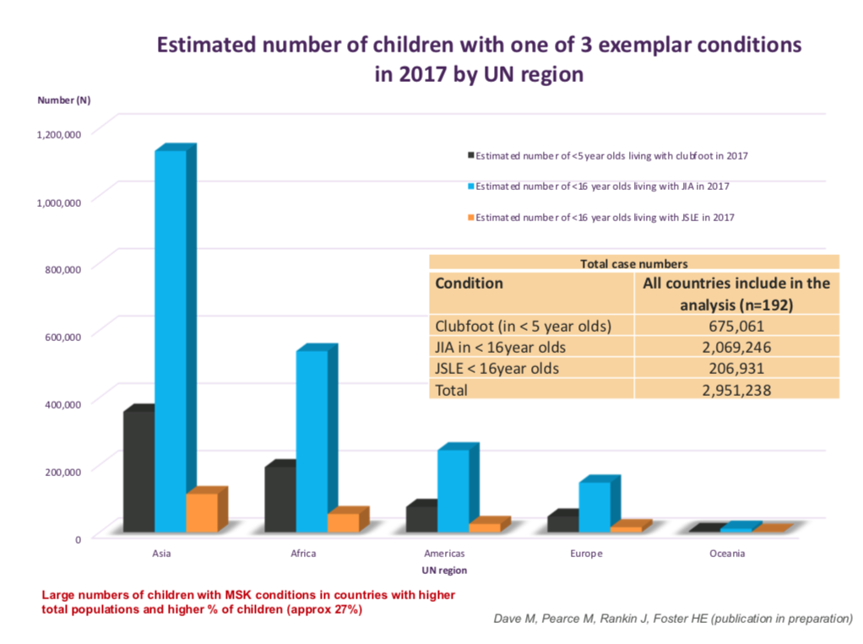
Helen Foster

Slide 23
Awareness
Workforce capacity building
Models of care
Advocacy
Education and training
https://doi.org/10.1016/j.berh.2020.101566

Slide 24


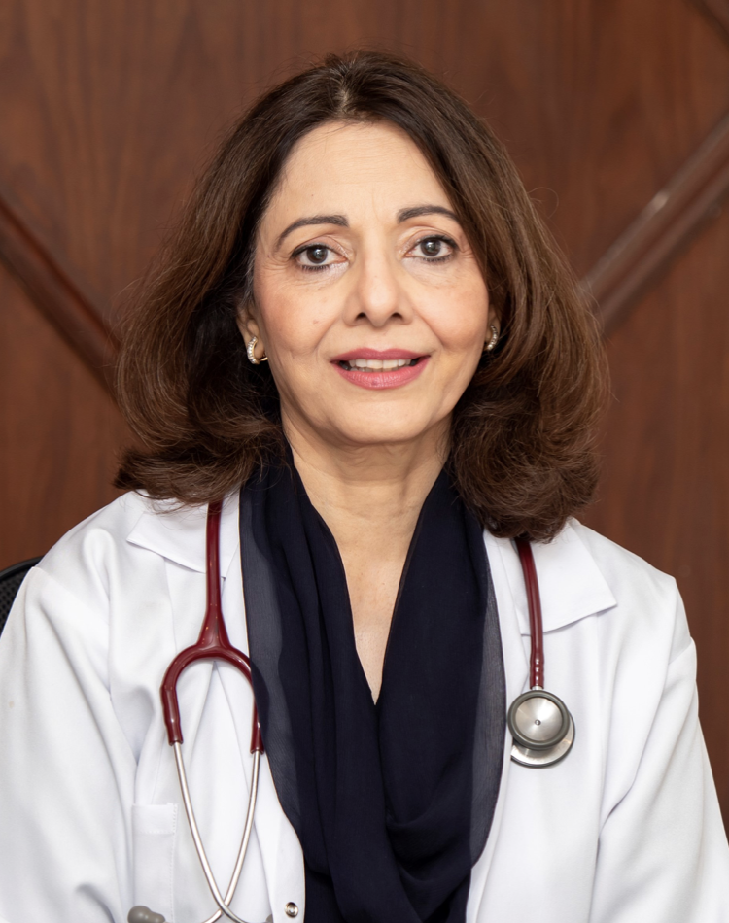
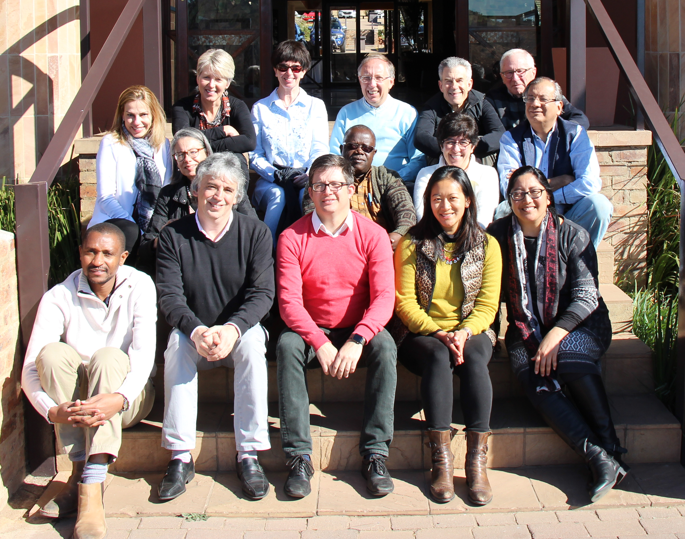
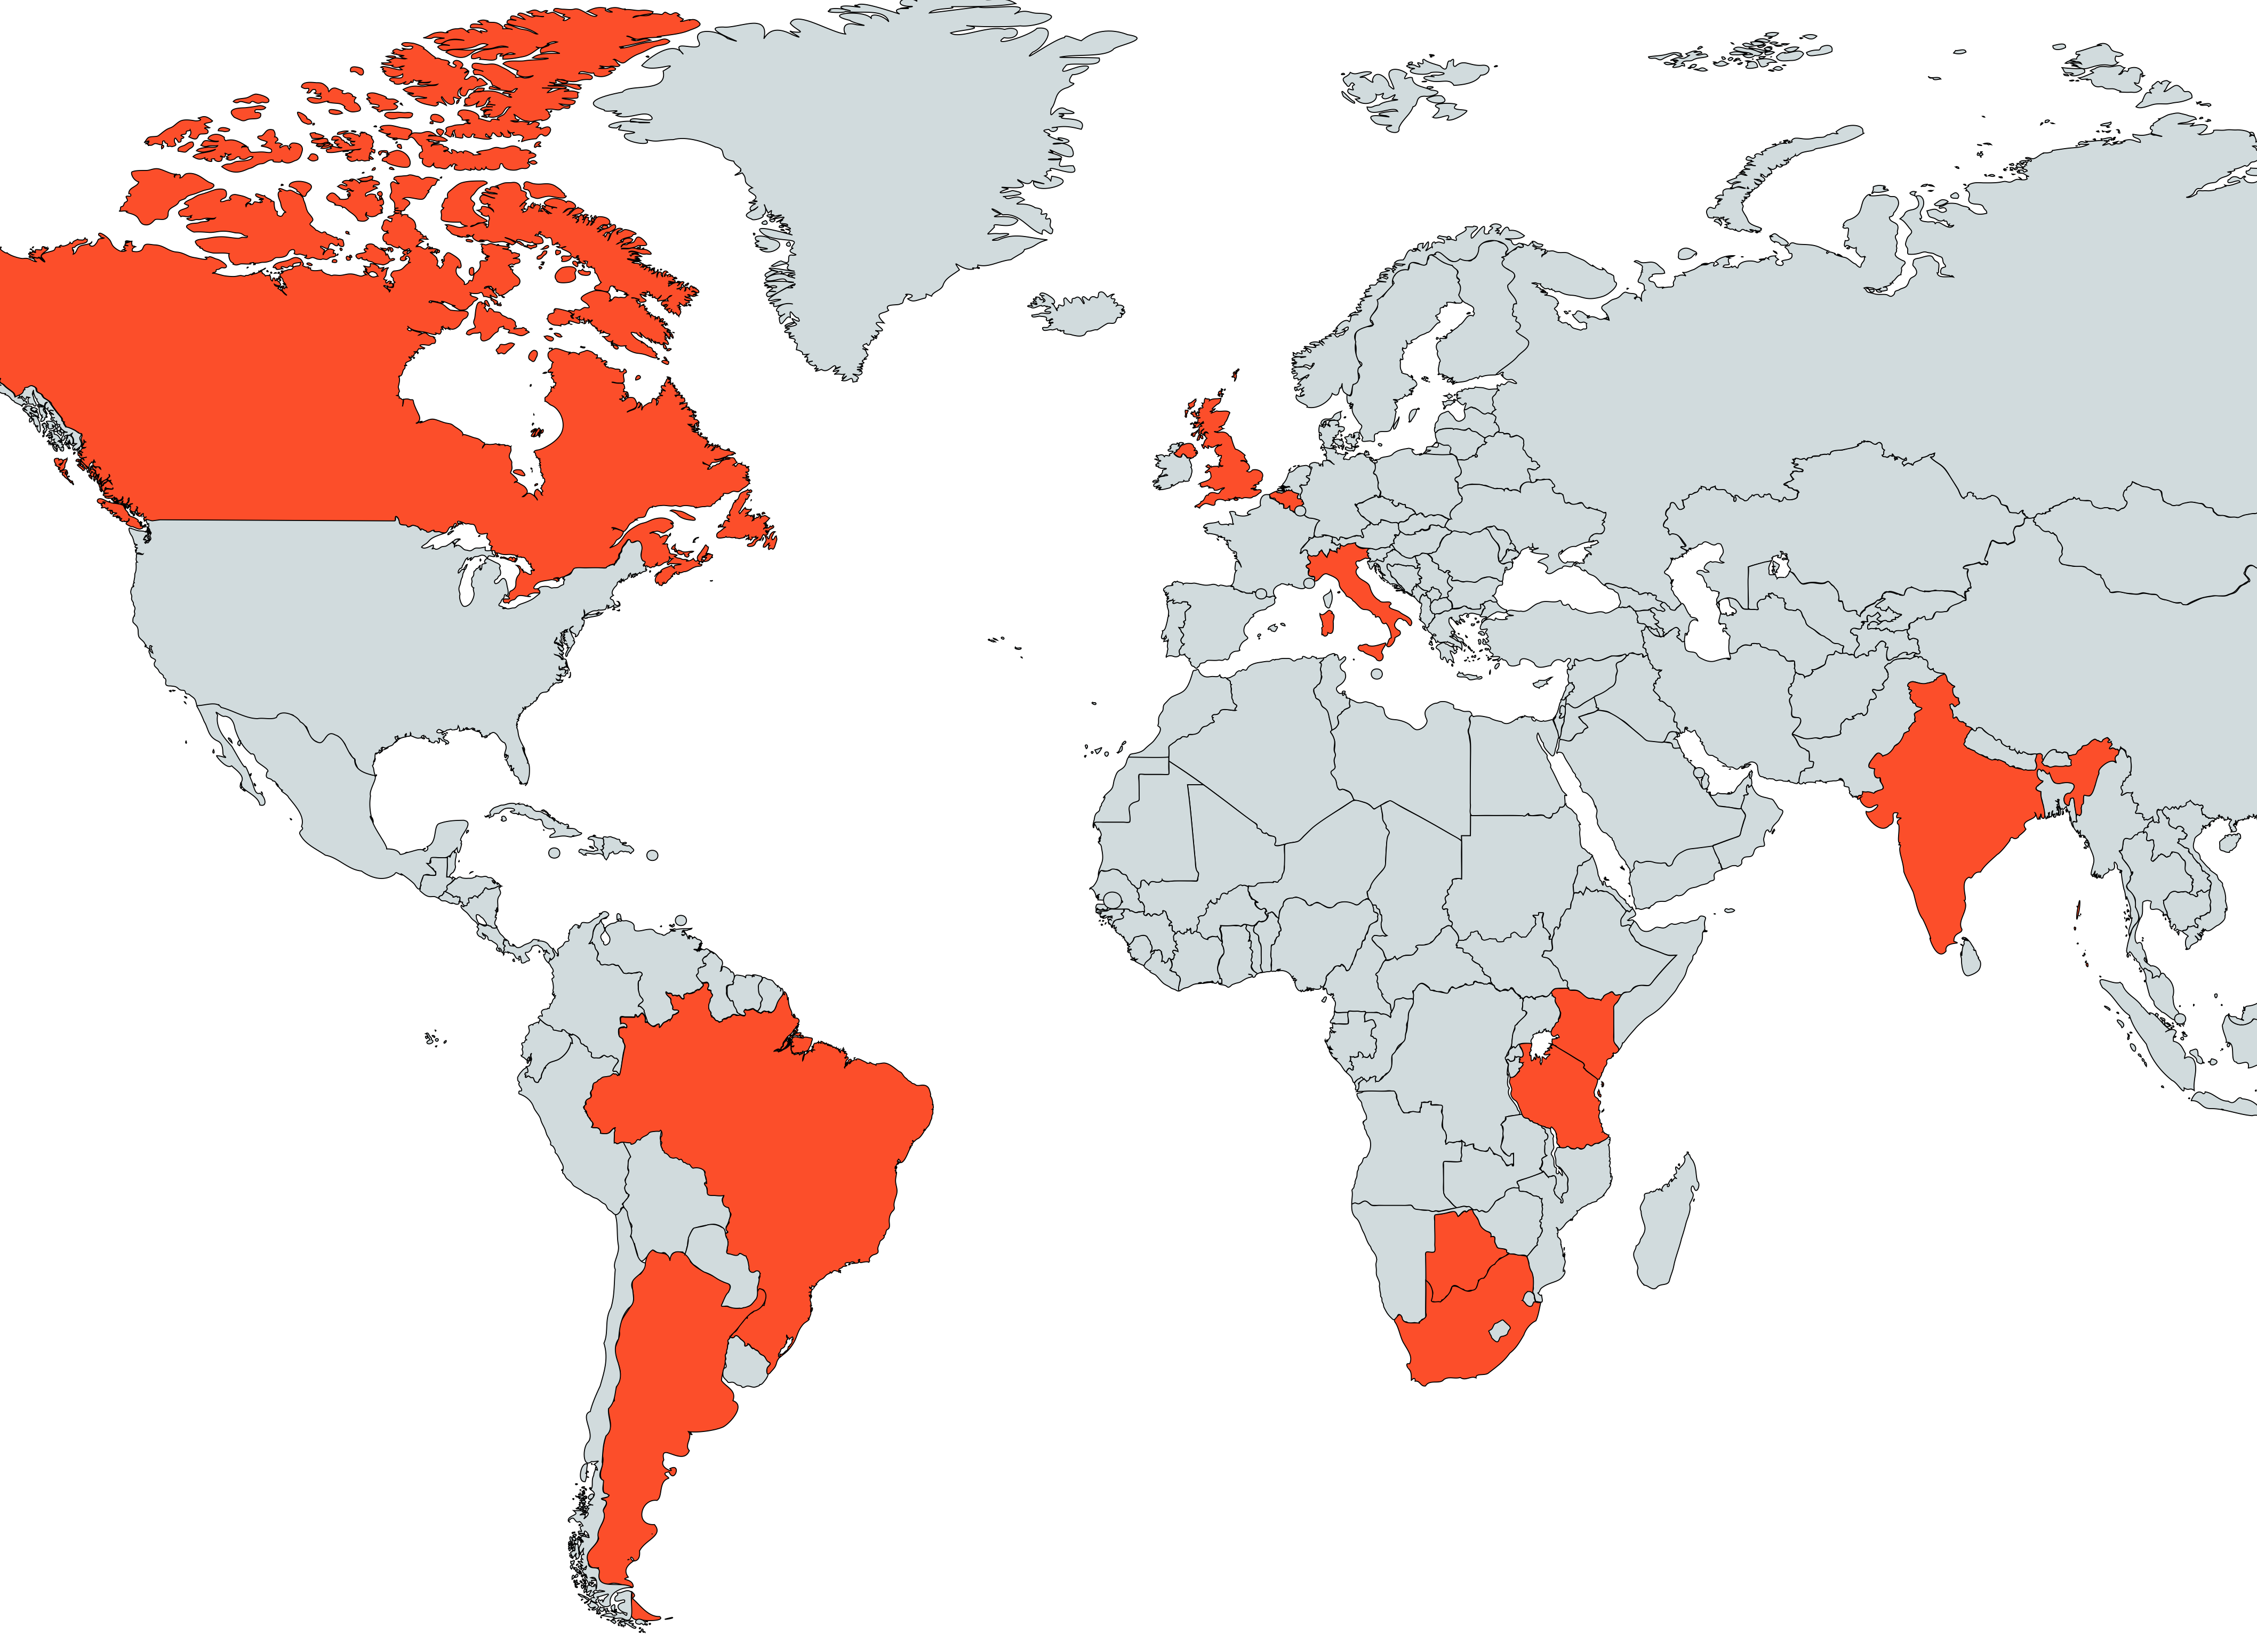
JAMLESS: Juvenile Arthrtitis management in Less Resourced Countries
Paediatric rheumatologists (PR) from Low Resource settings was convened
Steering group of international PR
Scott et al Clin Rheumatol 2013
JAMless
South East Asia in progress (2023)
Lupus Guidelines Less resourced Countries in preparation (2023)

Slide 25

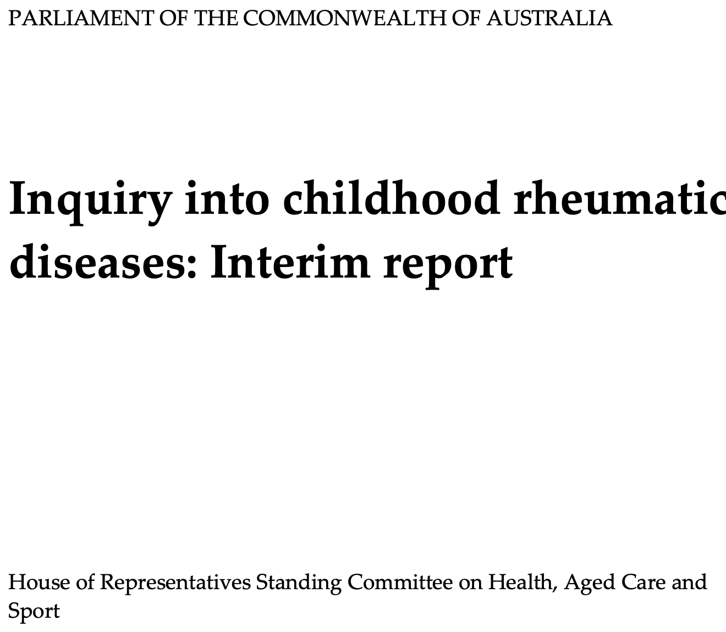
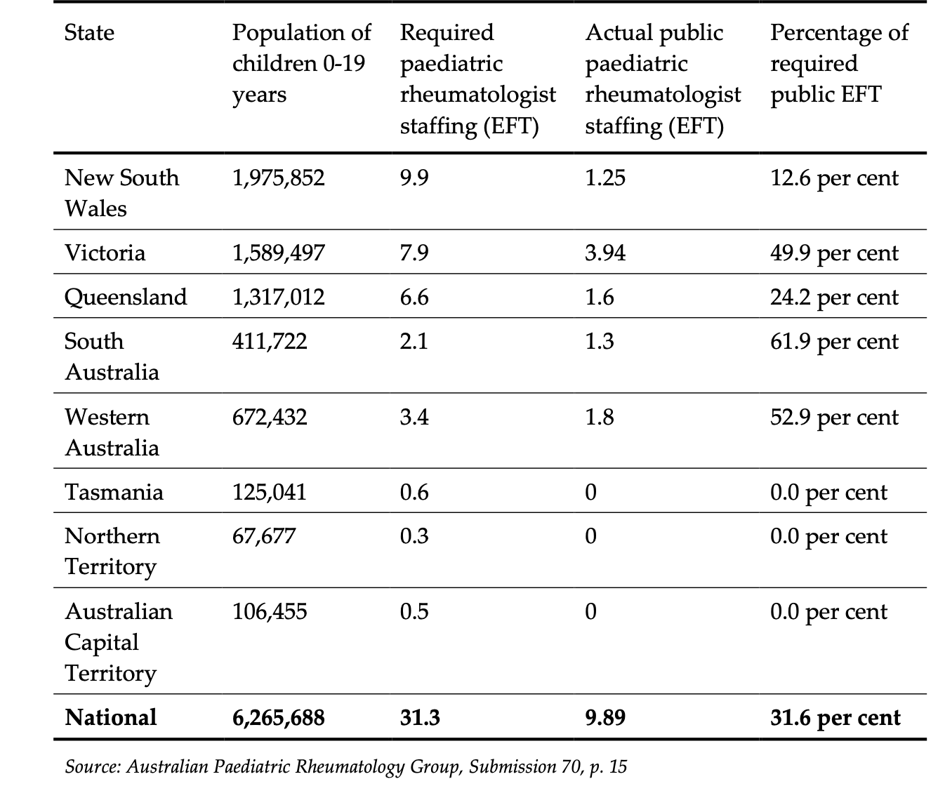

Slide 26
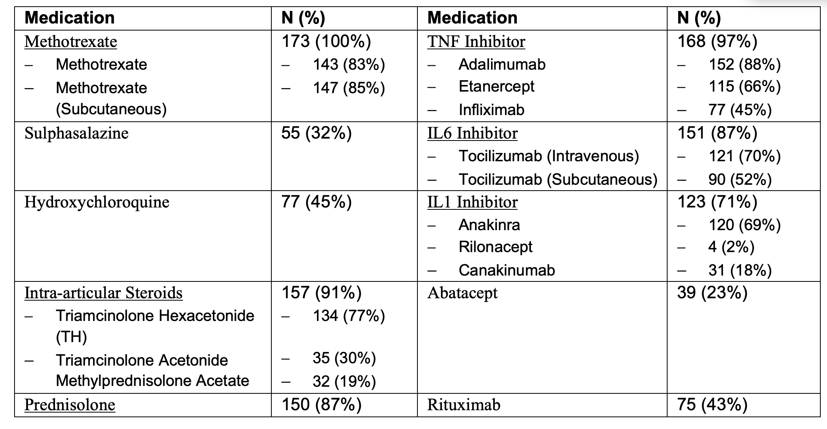
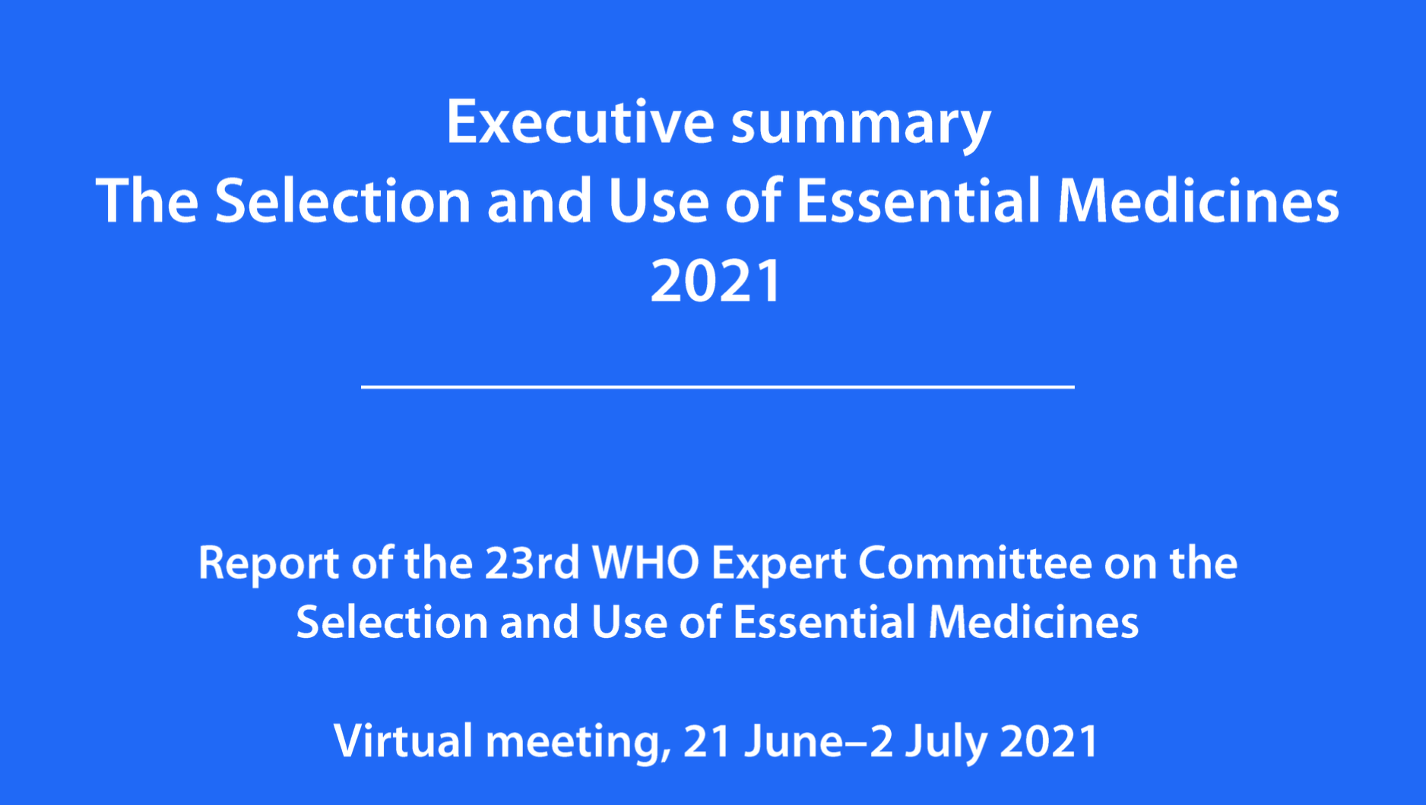

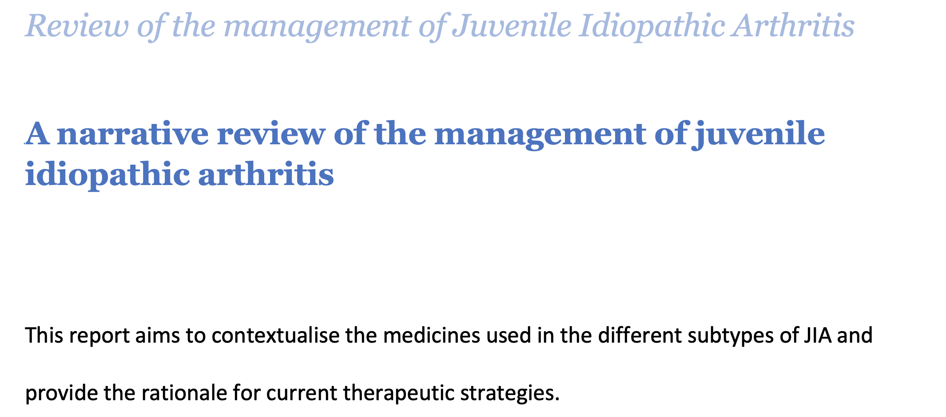
Foster, Slamang, Scott, Smith
2022 PReS Appoints Global Health Research Fellow to follow up guidelines submission with the WHO: Dr Waheba Slamang (South Africa)

